Slide 1
IE 411/511:
Visual Programming for Industrial Applications
Lecture Notes #5
Control Statements: Part 2

Slide 2
Module Learning Objectives
In this module you will learn:
Problem solving with additional control statements building blocks
To use the For…Next, Do…Loop While and Do…Loop Until repetition statements
To perform multiple selection using the
Select…Case statement
To use the Exit statement to break out of a repetition statement
To use the Continue statement to break out of the current iteration of a repetition statement
To use logical operators to form more complex conditions for decision making

Slide 3
For…Next Repetition Statement
Counter-controlled repetition with the Do While…Loop statement was introduced in the previous module
As discussed previously, counter-controlled repetition requires:
  The name of a control variable (or loop counter) that is used to determine whether the loop continues to iterate
  The initial value of the control variable
  The increment (or decrement) by which the control variable is modified each time through the loop
  The condition that tests for the final value of the control variable
    That is, whether looping should continue

Slide 4
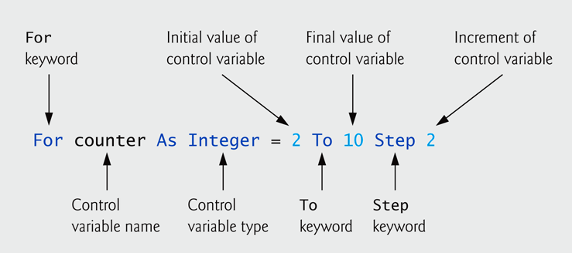
For…Next Repetition Statement
The For…Next repetition statement specifies counter-controlled repetition details in a single line of code
In general, counter-controlled repetition should be implemented with the For…Next repetition statement
The first line of the For…Next statement is called the header

Slide 5
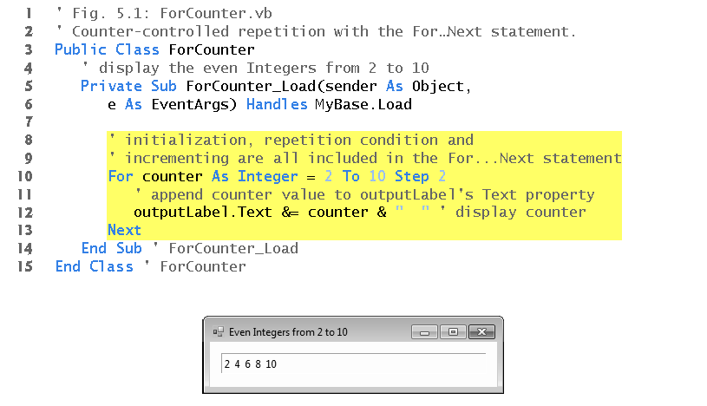
For…Next Repetition Statement
Here is an example of the use of a For…Next repetition statement
  The ForCounter_Load event handler is called when the program is executed

Slide 6
For…Next Repetition Statement (cont.)
The general form of the For…Next statement is
A For…Next statement can be represented by
an equivalent While statement as follows
For variable initialization To finalValue Step increment
statement
Next
variable initialization
While variable <= finalValue
statement
increment
End While

Slide 7
For…Next Repetition Statement (cont.)
The counter variable may be declared before the
For…Next statement
The starting value, ending value and increment portions of a For…Next statement can contain arithmetic expressions
  Expression are evaluated when the For…Next statement begins executing
If the loop-continuation condition is initially false,
the For…Next’s body is not performed
  Dim counter As Integer
  For counter = 2 To 10 Step 2
  total += 1
  Next

Slide 8
For…Next Repetition Statement (cont.)
Counter-controlled loops should not be controlled with floating-point variables
Although the value of the control variable can be
changed in the body of a For…Next loop, avoid
doing so, because this practice can lead to subtle errors
In nested For…Next loops, the use of the same
control-variable name in more than one loop is a
compilation error

Slide 9
For…Next Repetition Statement (cont.)
Local Type Inference
Recall that a local variable is any variable declared in the body of a method
In each For…Next statement presented so far, we declared the control variable’s type in the For…Next statement’s header
For any local variable that is initialized in its declaration, the variable’s type can be determined based on its initializer value
  This is known as local type inference

Slide 10
For…Next Repetition Statement (cont.)
Local Type Inference
Local type inference infers a local variable’s type
based on the context of initialization
For example
  Dim x = 7
    The compiler infers type Integer
  Dim y = -123.45
    The compiler infers type Double

Slide 11
For…Next Repetition Statement (cont.)
For counter As Integer = 1 To 10
The preceding For…Next header can now be written as
In this case, counter is of type Integer because it is initialized with a whole number
Local type inference can be used on any variable
that is initialized in its declaration
For counter = 1 To 10

Slide 12
For…Next Repetition Statement (cont.)
Varying the Control Variable
Vary the control variable from 1 to 10 in increments of 1
  For i = 1 To 10 or For i = 1 To 10 Step 1
Vary the control variable from 10 to 1 in decrements of 1
  For i = 10 To 1 Step -1
Vary the control variable from 7 to 77 in increments of 7
  For i = 7 To 77 Step 7
Vary the control variable from 20 to 2 in decrements of 2
  For i = 20 To 2 Step -2

Slide 13
Interest Calculator App
In-Class Exercise
Where
  P is the original amount invested (i.e., the principal)
  r is the annual interest rate (e.g., 5%)
  n is the number of years
  A is the amount on deposit at the end of the n^{th} year
A person invests $1000.00 in a savings account. Assuming that all the interest is left on deposit, calculate and display the amount of money in the account at the end of each year for up to 10 years. Allow the user to specify the principal amount, the interest rate and the number of years. Use the following formula:
A = P (1 + r) ^{n}

Slide 14
Interest Calculator App (cont.)
In-Class Exercise
This problem involves a loop that performs the indicated calculation for each year the money remains on deposit
  Do not use variables of type Single or Double to perform precise monetary calculations; use the type Decimal instead
Avoid placing inside a loop the calculation of an expression whose value does not change each time through the loop
  Such an expression should be evaluated only once and prior to the loop

Slide 15
Interest Calculator App (cont.)
In-Class Exercise
The NumericUpDown control is introduced
  Limits a user’s choices to a specific range of values (1 to 10)
  The Minimum and Maximum properties specify the starting and ending values in the range
  Its Value property specifies the current value displayed in the control. You can also use this property programmatically to obtain the current value displayed
  The Increment property specifies by how much the current number control changes

Slide 16
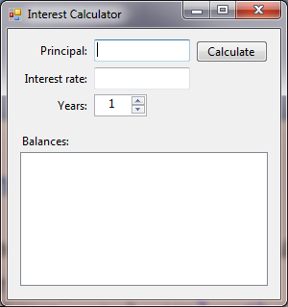
Interest Calculator App (cont.)
In-Class Exercise
GUI for Interest Calculator app
frmInterestCalculator
lblPrincipal
cmdCalculate
lblInterestRate
txtPrincipal
lblYears
txtInterestRate
lblBalances
nudYears
lstBoxResults

Slide 17
Formulating Algorithms
Nested Repetition Statements
Consider the following problem statement
Your program should draw the square as follows:
  Input the fill character and side length of the square.
  Use a NumericUpDown control to strictly limit the side length to the exact range of allowed values.
  Use repetition to draw the square by displaying only one fill character at a time.
Write a program that displays in a TextBox a filled square consisting solely of one type of character, such as the asterisk (*). The side of the square (1 to 20) and the character to be used to fill the square should be entered by the user

Slide 18
Formulating Algorithms (cont.)
Nested Repetition Statements
A few observations regarding the problem statement:
  The program must draw side rows, each containing side-fill characters, where side is the value entered by the user
  Counter-controlled repetition should be used
  Four variables should be used
    One that represents the side length of the square
    One that represents (as a String) the fill character to be used
    One that represents the row in which the next symbol should appear, and
    One that represents the column in which the next symbol should appear

Slide 19
Formulating Algorithms (cont.)
Nested Repetition Statements
Complete Pseudocode

Slide 20
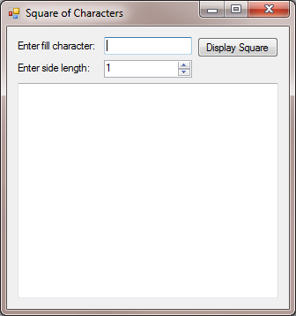
Formulating Algorithms (cont.)
Nested Repetition Statements
GUI for the Square of Characters app
frmSqrOfCharacters
lblFillCharater
cmdDisplaySquare
lblSideLength
txtFillCharacter
nudSideLength
txtOutput

Slide 21
Select…Case Selection Statement
Occasionally, an algorithm contains a series of decisions that test a variable or expression separately for each value that the variable or expression might assume
  The algorithm takes different actions based on those values
The Select…Case multiple-selection statement handles such decision making
The expression following the keywords Select…Case is called the controlling expression
  If a matching Case is found for the controlling expression, the code in that Case executes
  Program control then proceeds to the first statement after the Select…Case statement

Slide 22
Select…Case Selection Statement (cont.)
If no match occurs between the controlling expression’s value and a Case label, the optional Case Else executes
  If present, the Case Else must be the last Case
Case statements can use relational operators
Case Is < 0
Multiple values can be tested in a Case statement
Case 0, 5 To 9
The controlling expression also may be a String or Object

Slide 23
Select…Case Selection Statement (cont.)
Avoiding Errors
Duplicate Case statements are logic errors
  At run time, the first matching Case is executed
If the value on the left side of the To keyword in a Case statement is larger than the value on the right side, the Case is ignored
Provide a Case Else in Select…Case statements
  Cases not handled in a Select…Case statement are ignored unless a Case Else is provided
  The inclusion of a Case Else statement can facilitate the processing of exceptional conditions

Slide 24
Select…Case Selection Statement (cont.)
In-Class Exercise
Write a program that allows an instructor to enter numerical grades between 0 and 100 and displays the following in a Label control
  The sum of all the grades
  The average of the grades
  A tally of the total number of A+, A, B, C, D and F grades
  The number of students that received a perfect score
The grade equivalency table is as follows:
  Grade = 100 A+ 79 =< Grade <= 70 C
  99 =< Grade <= 90 A 69 =< Grade <= 60 D
  89 =< Grade <= 80 B Grade <= 60 F

Slide 25
Select…Case Selection Statement (cont.)
In-Class Exercise
An extra counter is used to display the number of students who received a perfect score of 100 on the exam
Instance Variable
  In this example, a variable is declared in the class, but outside all of the class’s event-handling methods
  Such variables (called instance variables) are special because they can be used by all of the class’s methods
  Instance variables also retain their values, so a value set by one method in the class can be used by another method

Slide 26
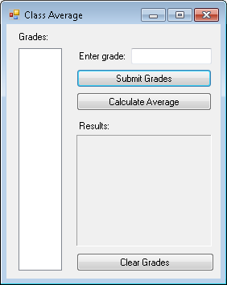
Select…Case Selection Statement (cont.)
In-Class Exercise
GUI for the modified Class Average app
frmClassAverage
lblGrades
txtGrade
lblGrade
cmdEnterGrade
cmdCalculateAvg
lstBoxGrades
lblClassAvg
lblClassAvgResults
cmdClearGrades

Slide 27
Using Exit in Repetition Statements
An Exit statement causes the program to exit immediately from a repetition statement
  Exit For and Exit While cause immediate exit from For…Next and While…End While loops, respectively
  The Exit Do statement can be executed in any Do statement
These statements are used to alter a program’s flow of control

Slide 28
Using Continue in Repetition Statements
The Continue statement skips to the next iteration of the loop
  Continue For and Continue While are used in For...Next and While loops, respectively
  The Continue Do statement can be executed in any Do statement
Continue For increments the control variable by the Step value

Slide 29
Logical Operators
A condition is an expression that results in a Boolean value
  i.e., True or False
So far, only simple conditions have been considered
  e.g., count <= 10, total > 1000, number <> -1
Each selection and repetition statement evaluated only one condition with one of the operators >, <, >=, <=, = and <>

Slide 30
Logical Operators (cont.)
To make a decision that relied on the evaluation of multiple conditions, tests were performed in separate statements or in nested If…Then or If…Then…Else statements
To handle multiple conditions more efficiently, the logical operators can be used to form complex conditions by combining simple ones
  And
  Or
  AndAlso
  OrElse
  Xor
  Not

Slide 31
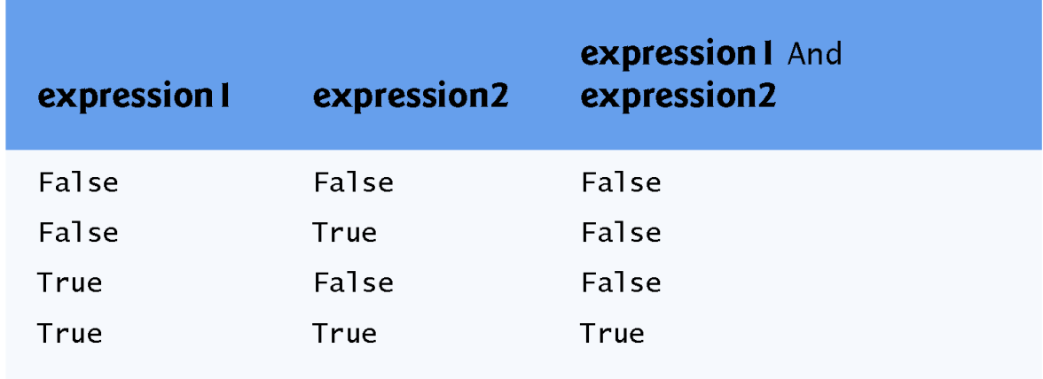
Logical Operators
The logical And operator can be used as follows
The If…Then statement considers the combined condition
Below is the truth table for the And operator
If gender = "F" And age >= 65 Then
seniorFemales += 1
End If

Slide 32
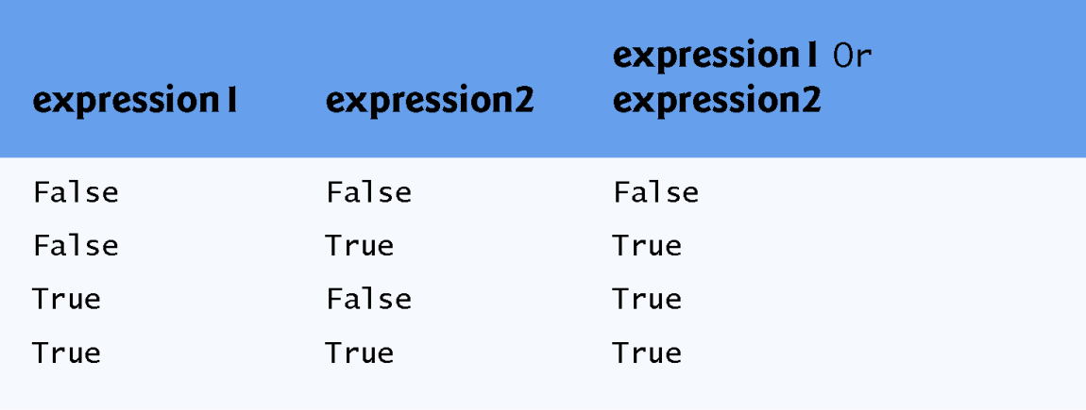
Logical Operators (cont.)
Logical Or Operator
The Or operator is used in the following segment
Below is the truth table for the Or operator
If semesterAverage >= 90 Or finalExam >= 90 Then lblResult.Text = "Student grade is A"
End If

Slide 33
Logical Operators (cont.)
Logical AndAlso and OrElse Operators
AndAlso and OrElse are similar to the And and Or operators
  (gender = "F" AndAlso age >= 65)
The preceding expression stops evaluation immediately if gender is not equal to “F”
  This is called short-circuit evaluation

Slide 34
Logical Operators (cont.)
In expressions using operator AndAlso, if the separate conditions are independent of one another, place the condition most likely to be false as the leftmost condition
In expressions using operator OrElse, make the condition most likely to be true the leftmost condition
Each of these suggestions can reduce a program’s execution time

Slide 35
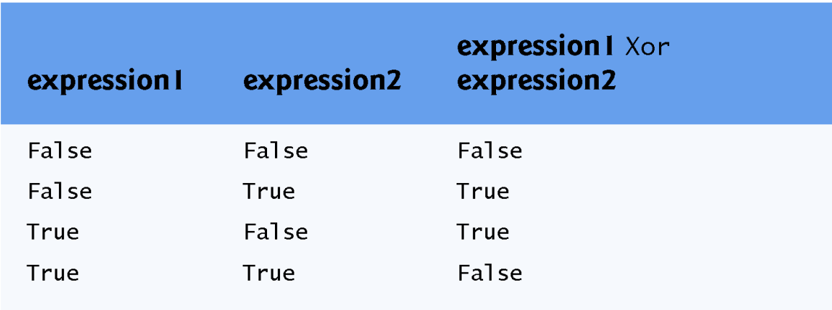
Logical Operators (cont.)
Logical Xor Operator
A condition containing the logical exclusive OR (Xor) operator is true if and only if one of its operands results in a true value and the other results in a false value
Below is the truth table for the Xor operator

Slide 36
Logical Operators (cont.)
Logical Not Operator
The Not operator enables you to “reverse” the meaning of a condition
The logical negation operator is a unary operator, requiring only one operand
The parentheses are necessary because Not has a higher precedence than the equality operator
If Not (grade = sentinelValue) Then
lblResult.Text = "The next grade is " & grade
End If

Slide 37
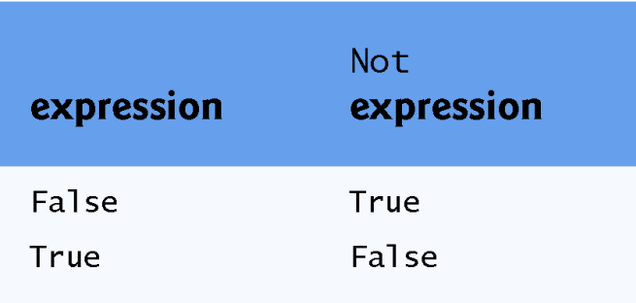
Logical Operators (cont.)
You can avoid using Not by expressing the condition differently
Below is the truth table for the Not operator
If grade <> sentinelValue Then
lblResult.Text = "The next grade is " & grade
End If

Slide 38
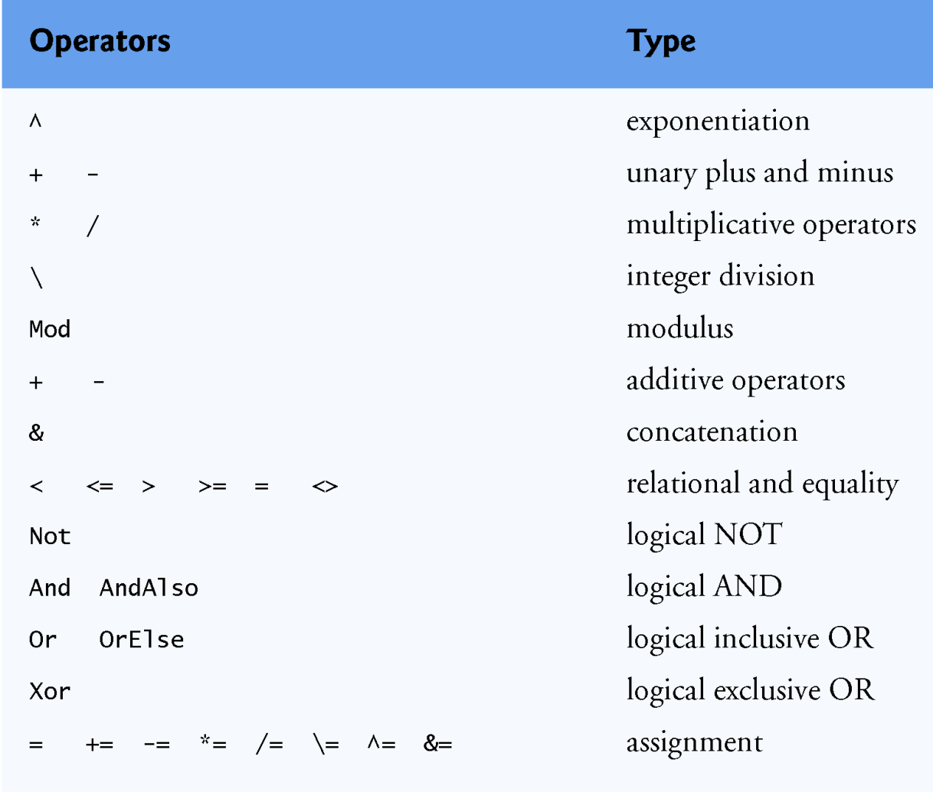
Logical Operators Precedence
The table below displays the operators in decreasing order of precedence

Slide 39
Dental Payment Calculator App
In-Class Exercise
To demonstrate some of the logical operators, consider the following problem
A dentist’s office administrator wishes to create an app that employees can use to bill patients. The app must allow users to enter the patient’s name and specify which services were performed during the visit. The app will then calculate the total charges. If a user attempts to calculate a bill before any services are specified, or before the patient’s name is entered, an error message will be displayed informing the user that necessary input is missing.

Slide 40
Dental Payment Calculator App (cont.)
In-Class Exercise
Two new controls are introduced in this app
  CheckBox
  Message Dialog
A CheckBox is a small square that either is blank or contains a check mark
Programs often use message dialogs to display important messages to the user

Slide 41
Dental Payment Calculator App (cont.)
In-Class Exercise
A CheckBox is known as a state button
  i.e., it can be in the “on” state or the “off” state
  If the CheckBox is “on” (checked), its Checked property has the Boolean value True; otherwise, it is False (“off”)
When a CheckBox is selected, a check mark appears in the box
  Any number of CheckBoxes can be selected at a time, including none at all
The text that appears alongside a CheckBox is called the CheckBox label and is specified with the Text property

Slide 42
Dental Payment Calculator App (cont.)
In-Class Exercise
Class MessageBox creates message dialogs
The MessageBox method Show displays the dialog
The Show method takes four arguments:
  The first is the String that is displayed in the message dialog
  The second is the String that is displayed in the message dialog’s title bar
  The third and fourth are predefined constants that specify the Button(s) and the icon to show on the dialog, respectively

Slide 43
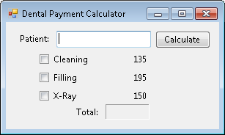
Dental Payment Calculator App (cont.)
In-Class Exercise
GUI for the Dental Payment app
frmDentalPayment
lblGrades
txtGrade
chkBoxCleaning
chkBoxFilling
txtName
chkBoxXray
lblTotalCost
lblTotal

Slide 44
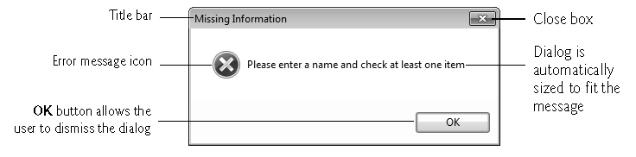
Dental Payment Calculator App (cont.)
In-Class Exercise
GUI for the Dental Payment app
  Message Dialog

